Slide 1
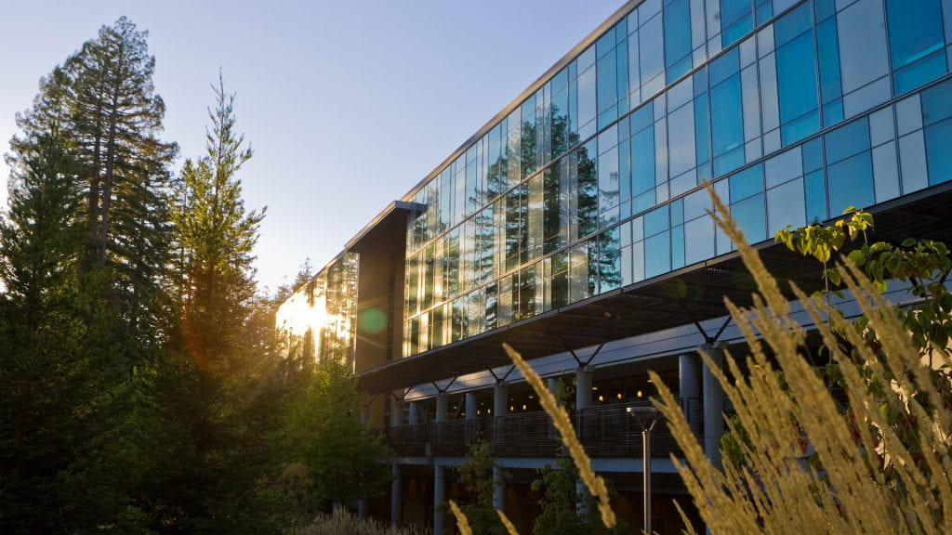
Inferring brain structure and function using differentiable MRI simulators
Notes:
Let's change the title of my talk to: Inferring brain structure and function using differentiable MRI simulations. And I'll try to talk as much as I can on fMRI.
Abstract: Accurate inference of brain structure and function is a longstanding goal in neuroscience. MRI technology can significantly assist with this, and MRI simulators which simulate the physics underlying the MRI scanners can be used 1) towards generating synthetic data and 2) towards the inference of brain structure and function by matching the synthetic scans with real scans. However, the matching process of a synthetic vs real scan requires an iterative optimization that is incredibly slow. Inspired by advancements in deep learning, we will show that differentiable MRI simulators can be used to infer gray-matter, white-matter and cerebrospinal fluid fraction maps from standard MRI scans (T1/T2/FSE/FLAIR/ ...). In addition, we will discuss how functional MRI simulators can be used for inferring functional activity in the brain based on fMRI time-series. Such fMRI pipelines could be used to infer latent brain functional "modes", identify optimal fMRI sequences to achieve an optimal functional readout, model the effect of the hemodynamic parameters which modulate the BOLD signal, and understand how structural connectivity can affect functional activity. Finally, we will discuss how fMRI-inferred functional activity can be used to inform whole-brain emulations at the macroscopic level.
---------------- Dear Razvan,
Thank you for confirming your participation, we are excited to engage with your presentation at the workshop.
I would like to share with you some more details about the workshop. Our prospective agenda for February 22 is as follows:
MinsStart time PSTAgenda item
108:00 amWorkshop welcome
208:10 amRandal Koene (Intro mini-talk)
458:30 amPhilip Shiu (Drosophila functionalization)
309:15 amQ&A / brainstorming
459:45 amJanne Lappalainen (Drosophila functionalization)
3010:30 amQ&A / brainstorming
4511:00 amRandal Koene (Inverse problem, System Identification)
3011:45 amQ&A / brainstorming
3012:15 pmBreak
4512:45 pmKonrad Kording (C.Elegans, ground-truthing)
301:30 pmQ&A / brainstorming
452:00 pmRazvan Marinescu (Synthetic data, (f)MRI)
302:45 pmQ&A / brainstorming
453:15 pmBrain emulation challenge platform introduction
304:00 pmOpen discussion
54:40 pmWorkshop closing
As you can see, there will be plenty of room for discussion and brainstorming, which also provides some flexibility regarding the duration of talks. Given the topics and the stated goals of the workshop, while you are free to talk about anything you wish, a suggestion of particular interest is if you can talk about uses of synthetic data in explorations of (f)MRI. The agenda assumes a talk of about 45 minutes with subsequent 30 minutes of Q&A/discussion, but feel free to adjust as best suits your topic.
If possible, please send us an abstract of your intended talk as soon as possible. There is no prescribed format or length for the abstract. A one paragraph abstract that roughly corresponds with the intended topic is perfectly fine.
We intend to send out to you the URL to join the workshop within 48 hours of the start of the workshop.
As we know, in established sub-fields of physics, biology, cosmology (etc) problems are generally carefully and concretely described, leading to well-formulated studies. We would love it if our interactions at this workshop can help the nascent domain of brain emulation in its effort to become similarly rigorous, in terms of goal specification and beyond.
I would also like to invite you to share the workshop with anyone who you think would be interested in participating, or who would benefit from immersion in the topic. The official landing page for the workshop is: https://carboncopies.org/
challenge2025
After the workshop, we aim to produce and publish a written report of the workshop, with your input of course, with a target date for publication approximately 1 month after the workshop.
Please feel free to reach out to me or anyone of our team members CC’ed in this email if you have questions or suggestions.
With sincere regards,
Randal Koene

Slide 2
Outline
Why MRI simulators?
Inferring brain structure using MRI simulators
Inferring brain function using fMRI simulators
fMRI for Whole Brain Emulation

Slide 3
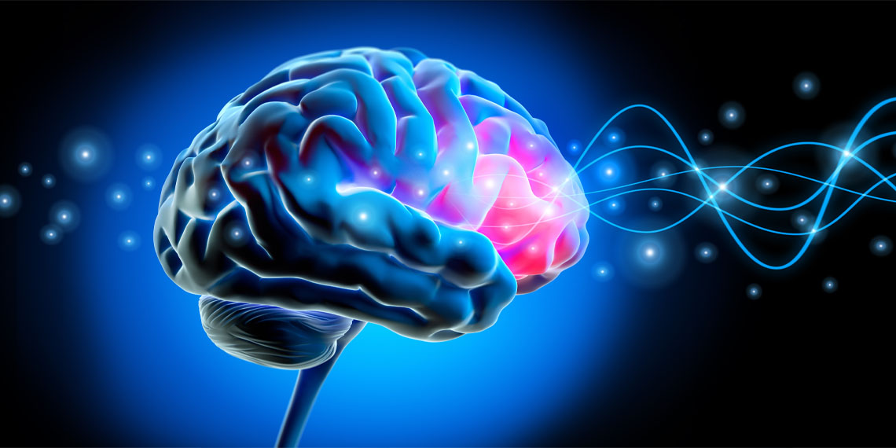
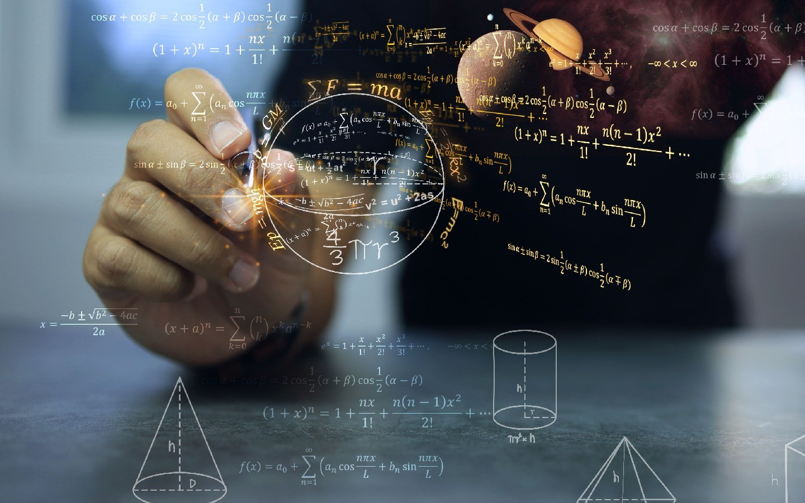
Part 1 Why MRI simulators?

Slide 4
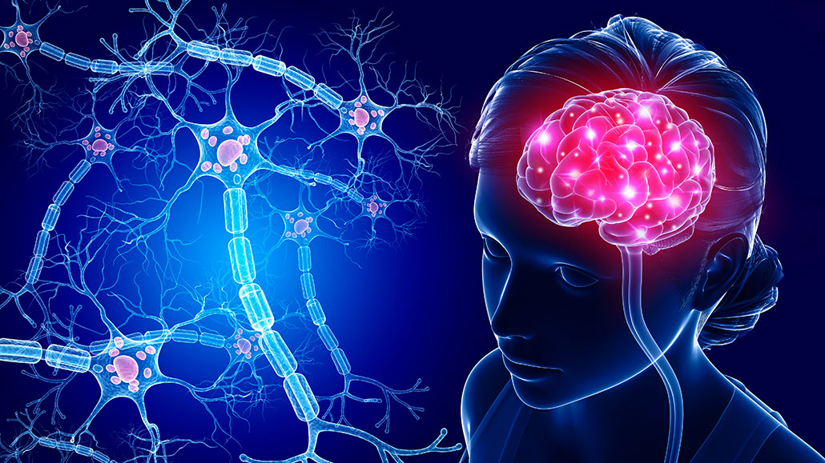
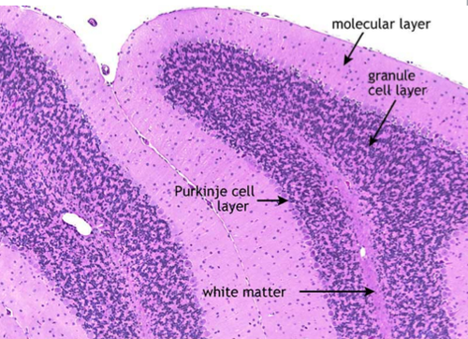
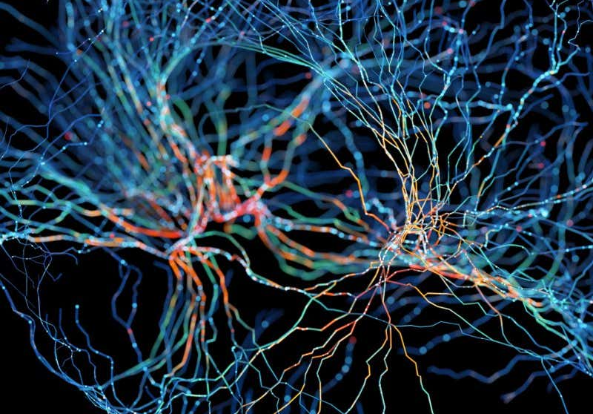
The dream of Brain Magnetic Resonance Imaging
See inside the brain, map and measure every neuron
Like histology, but in-vivo!

Slide 5
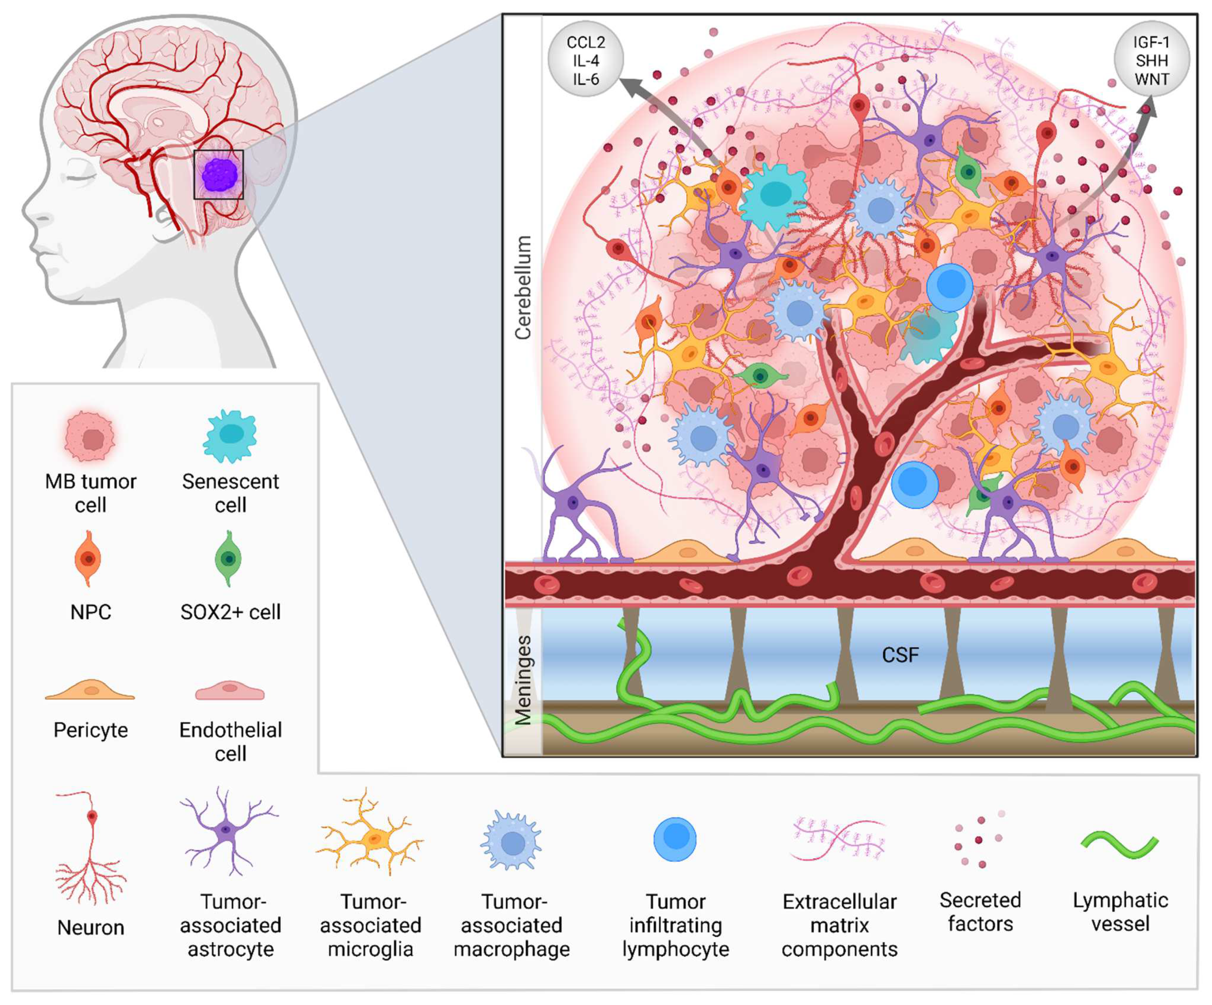
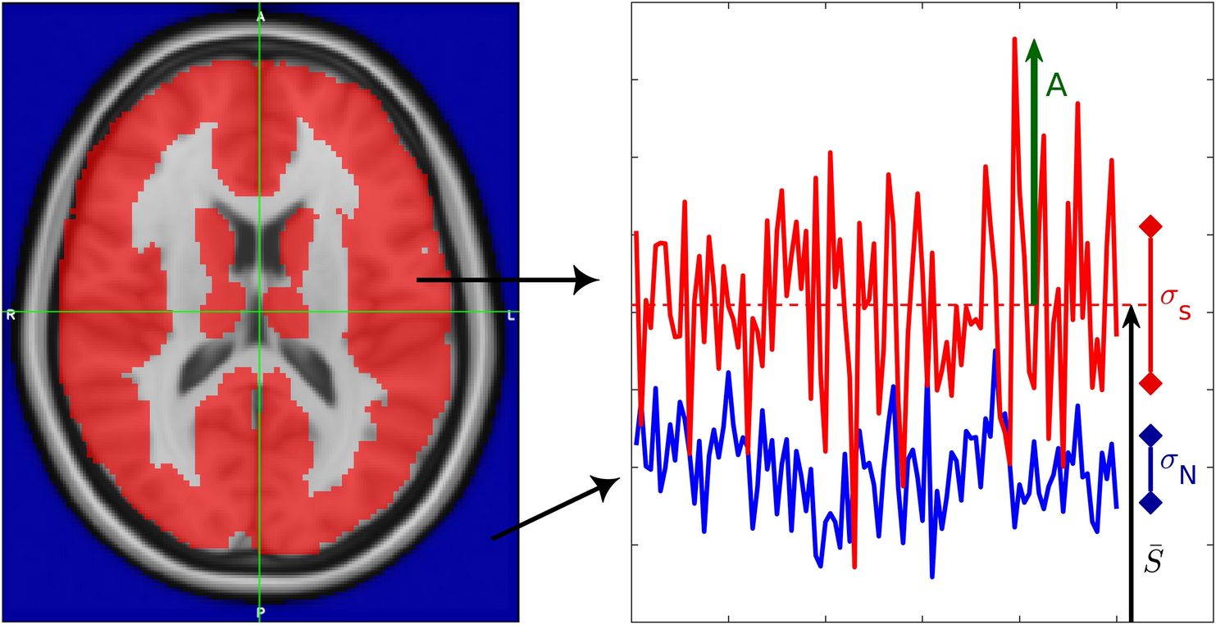
The dream of Brain Magnetic Resonance Imaging
Detect sophisticated disease biomarkers at different scales
High-level: subtle boundaries between structures, sub-structures, cortical layers, …
Low-level: De-myelination, axonal degeneration,
Detailed mapping of tumour macro-/micro-environments
Direct, noise-free measures of functional activity

Slide 6
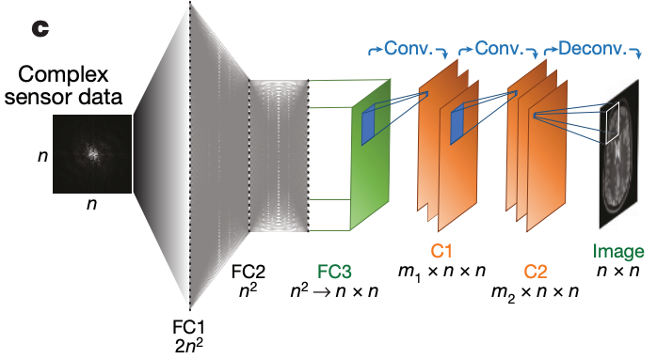
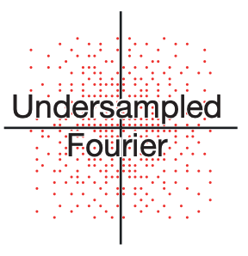
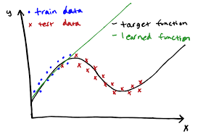
Supervised NN reconstruction of brain structure and function is difficult
Reconstruction with supervised neural nets (e.g. AUTOMAP) requires lots of input scans
Lack of strong inductive biases makes ill-posed reconstructions difficult
Distribution shifts cannot be modelled easily:
Δ MRI sequence
Δ anatomy
Δ noise model
Δ motion
MRI sequences cannot be optimized

Slide 7
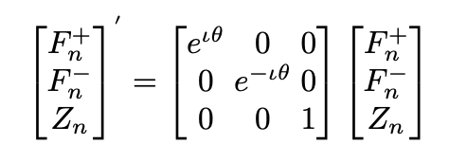
MRI Simulators help by offering strong physics-based inductive biases
Voxel magnetization is modelled in a Fourier F basis:
Each operation is modelled as a matrix operation:
Spin precession:
RF pulse:
Gradients: shifts in matrix rows/columns

Slide 8
How are MRI simulators helpful?
Simulate any MRI sequence
Generate an infinite amount of data of any contrast given any anatomical image as input
Infer digital twins of the brain that are given as input to the simulator
Optimize the MRI sequence

Slide 9
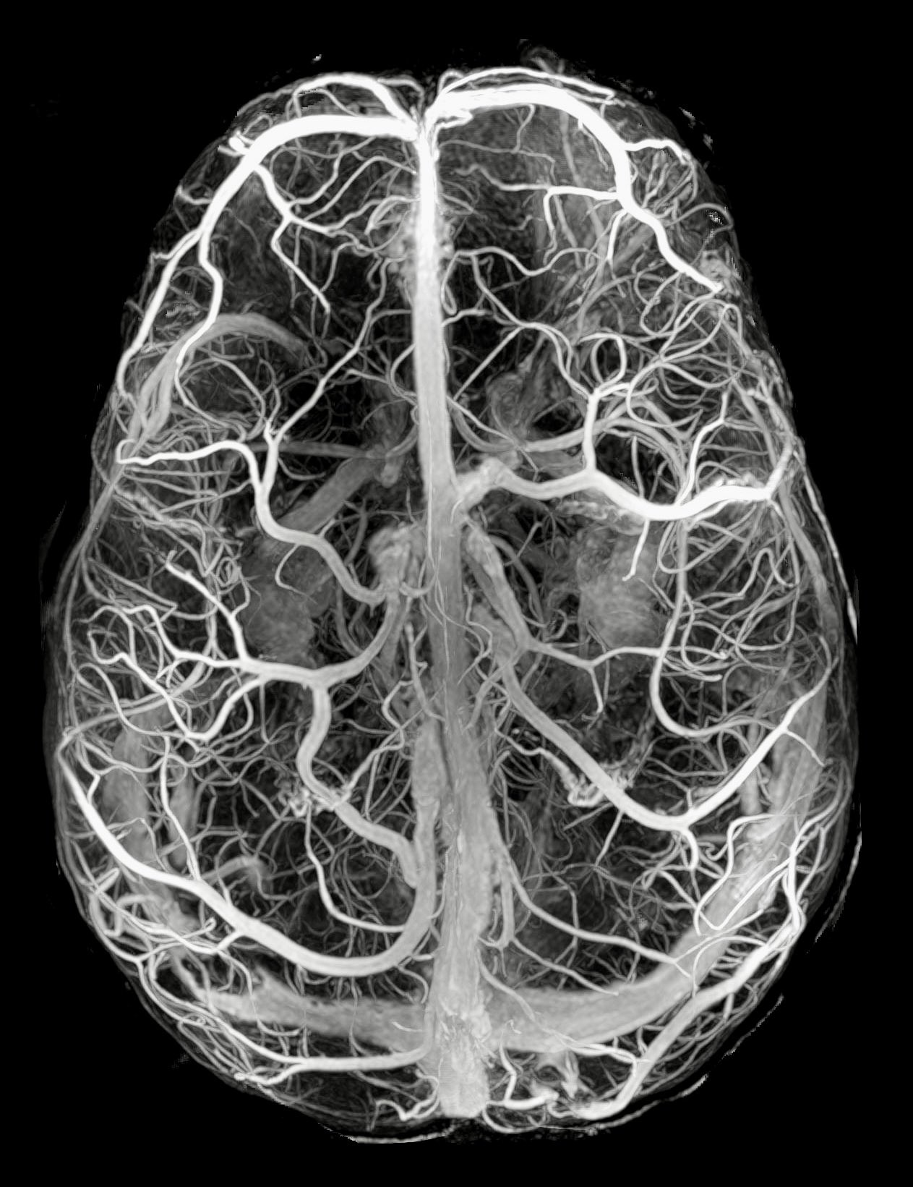
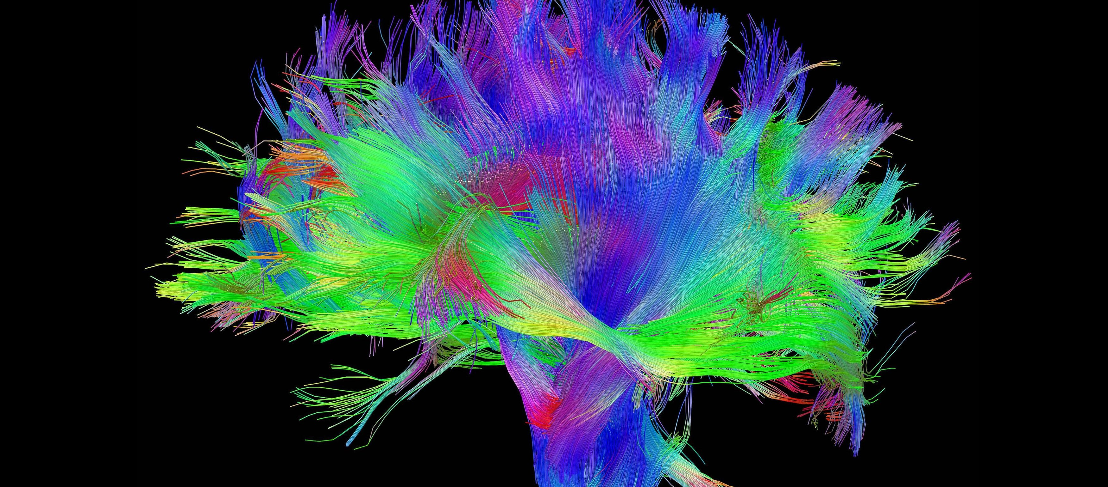
Part 2 Inferring brain structure with MRI simulators

Slide 10
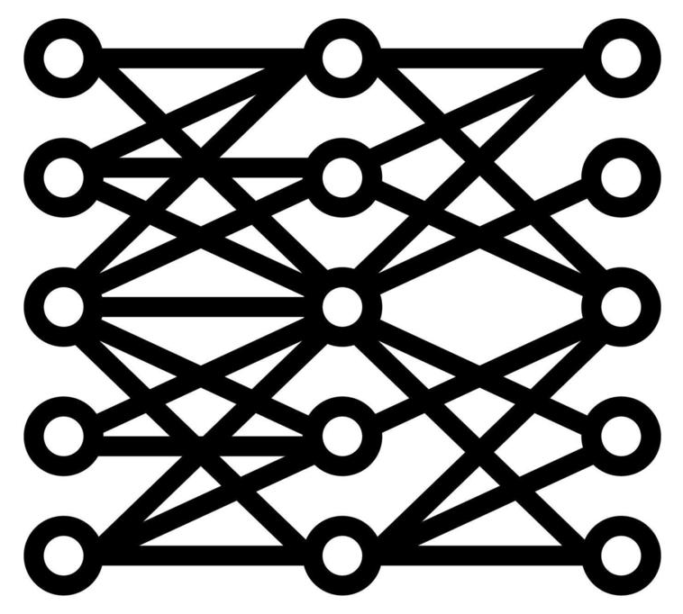
Differentiability is key towards efficient optimization of simulator inputs
MRI signal is a function of the digital phantom and several events: flip angles, gradients, relaxation, …
Can infer the brain digital twin (phantom) using stochastic gradient descent
Can further seamlessly integrate the differentiable simulator with neural networks
Without differentiability, gradient-free methods such as the simplex algorithms cannot work efficiently in high-dimensional spaces
Differentiable simulator
…
Loss

Slide 11
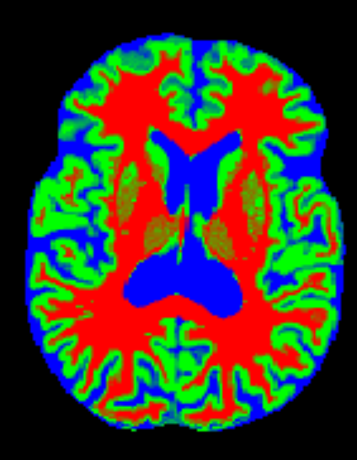
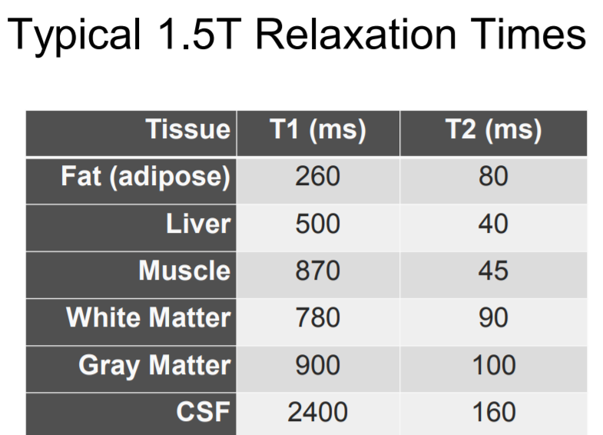
Brain digital twin optimization: once you have a differentiable simulator, how do you optimize a digital twin of the brain?
Digital twin
Back-propagate the loss to the digital twin
Inverse problem + ill-posed:
Forward process is a projection of the phantom on some space
Some MRI sequences are not sensitive to some tissues
T1/T2/PD
K-space
simulated T1-weighted
% GM
% WM
% CSF
MRI simulator
loss
Sequence params: TE, TR, flip angle, …
real T1-weighted
Gupta et al, ICML 2024 Differentiate Anything Workshop

Slide 12
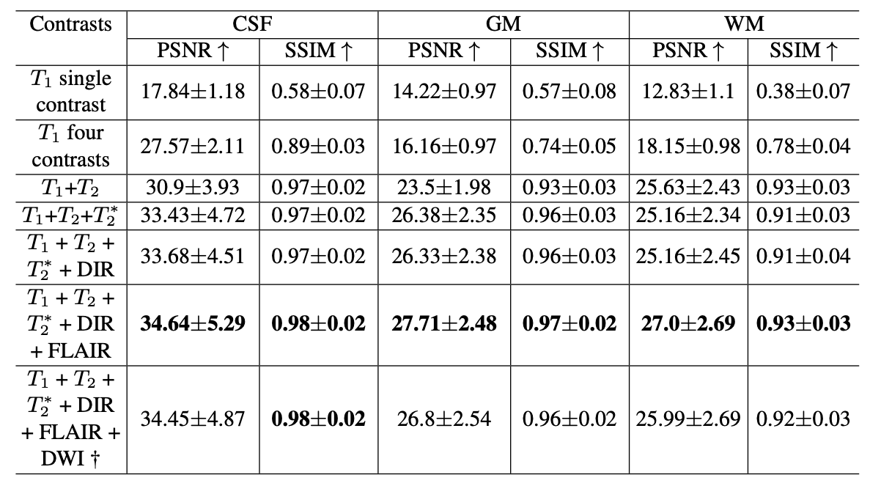
Results: we reconstructed patient-specific digital twins on the Brainweb dataset
This used 6 pulse sequences
Can do it with only 1 sequence also, but the problem becomes more ill-posed.
Gupta et al, ICML Differentiate Anything Workshop, 2023

Slide 13
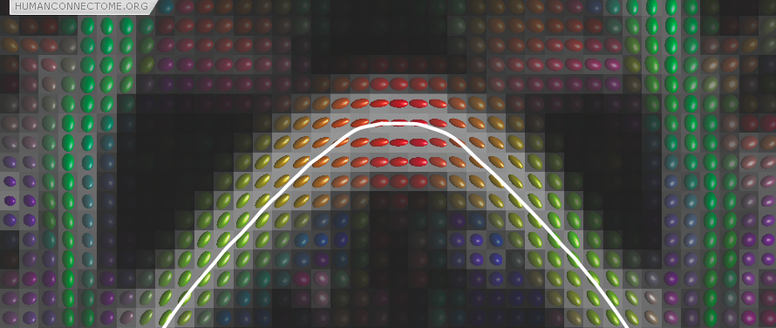
Reconstructing brain microstructure and white matter tracts
Why?
Brain microstructure is incredibly important in assessing many diseases
Build structural connectomes that can be used to instantiate models for whole-brain emulation

Slide 14
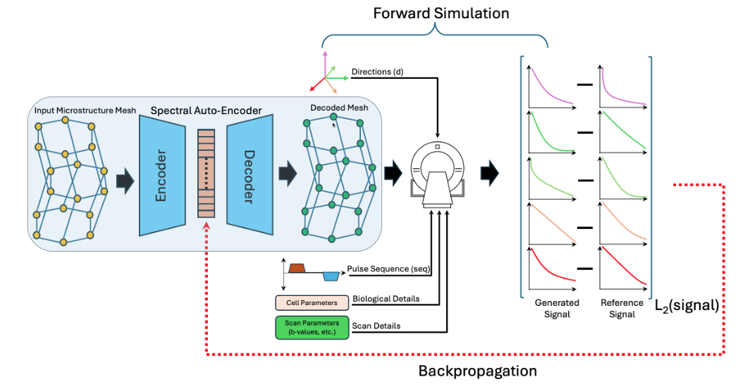
Reconstructing brain microstructure with a differentiable diffusion MRI simulator
Diffusion MRI simulators exist (e.g. Disimpy, SpinDoctor), but none are differentiable
We have been building a PDE-based diffusion MRI simulator that is differentiable (in PyTorch) based on SpinDoctor
Aim: use differentiable dMRI simulator to infer brain microstructure as arbitrary 3D meshes
Khole et al, ISMRM 2025 + submitted to ICML 2025
+ ISMRM 2025 Workshop on 40 Years of Diffusion

Slide 15
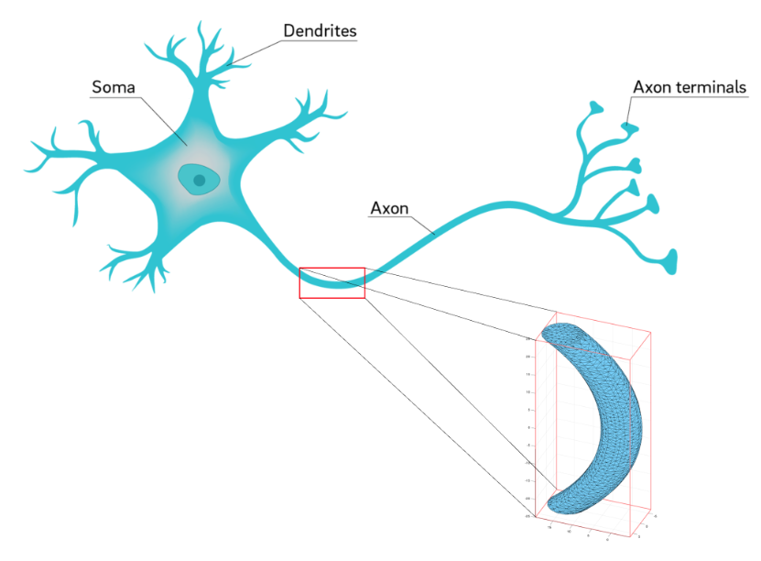
Arbitrary shapes can be reconstructed through gradient-based learning
Khole et al, ISMRM 2025 + ISMRM 2025 Workshop on “40 Years of Diffusion”

Slide 16
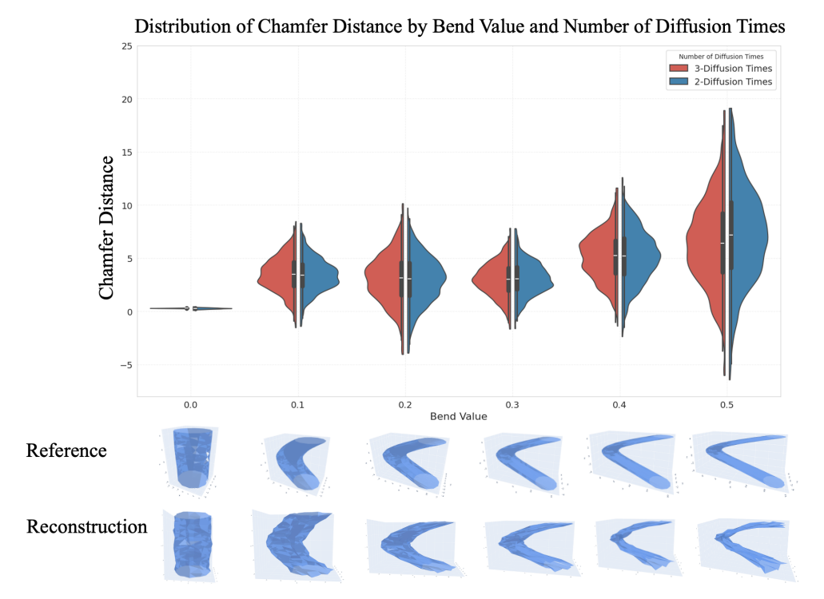
Our method can also reconstruct beaded or bent meshes
Khole et al, ISMRM 2025 + ISMRM 2025 Workshop on “40 Years of Diffusion”

Slide 17
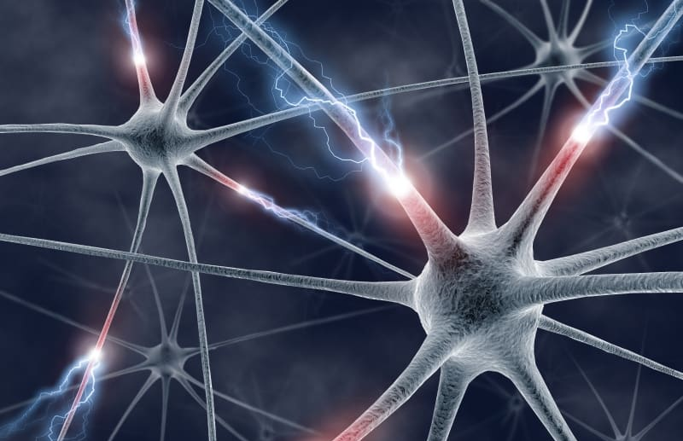
Part 3 Inferring brain function using fMRI simulators

Slide 18
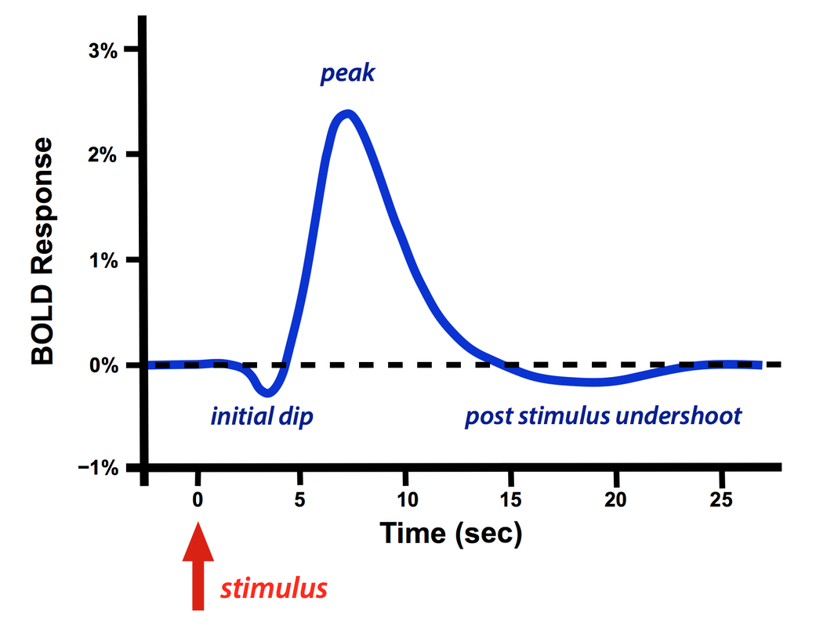
fMRI can read functional activity of neurons
Based on Blood-level oxygenation (BOLD) contrast
Uses EPI, a fast MRI sequence
Functional signal is 2-3% of total signal
Reconstruction involves testing for statistical significance in signal difference

Slide 19
POSSUM: one of the most accurate fMRI simulators
Drobnjak et al, MRM 2006
Simulates the Bloch equation:
Transverse (T₂) relaxation follows:
BOLD is simulated using a time-varying T₂*(t) function:
Building T₂*(t) involves generating a time-varying stimuli S(T) and convolving it with a hemodynamic response function (HRF)

Slide 20
Landscape of fMRI simulators

Slide 21
Hypothesis: Can efficiently reconstruct functional activity with fMRI simulators
Functional activity
BOLD response
Simulated K-space
HRF
fMRI simulator
EPI sequence params: TE, TR, flip angle, …
loss
Real K-space
Need a differentiable fMRI simulator
Reconstruction with fewer assumptions:
no need for voxel independence
no need for statistical testing

Slide 22
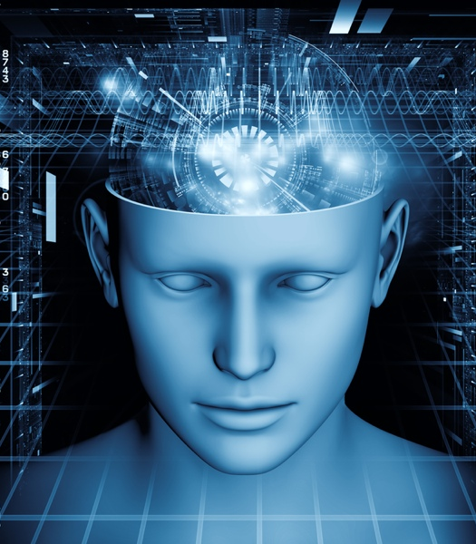
Part 4 fMRI for Whole Brain Emulation

Slide 23
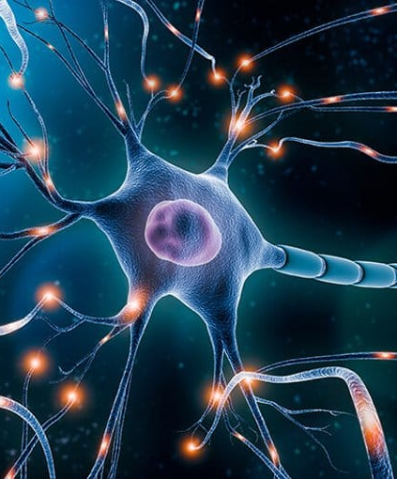
Bottom-up whole brain emulation requires high-level calibration
Most promising WBE models will emulate activity at individual neuron level
Cognitive processes will emerge from low-level neuron interactions:
Medium level: Pattern recognition, memory formation, motor coordination, attention mapping, sensory processing, basic sound production
High level: Abstract thinking, creativity, imagination, language, symbolic thought, ethics, goal setting & agency
Emergent phenomena will need to be calibrated with actual measurements of such processes

Slide 24
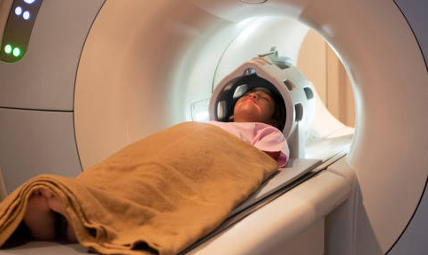
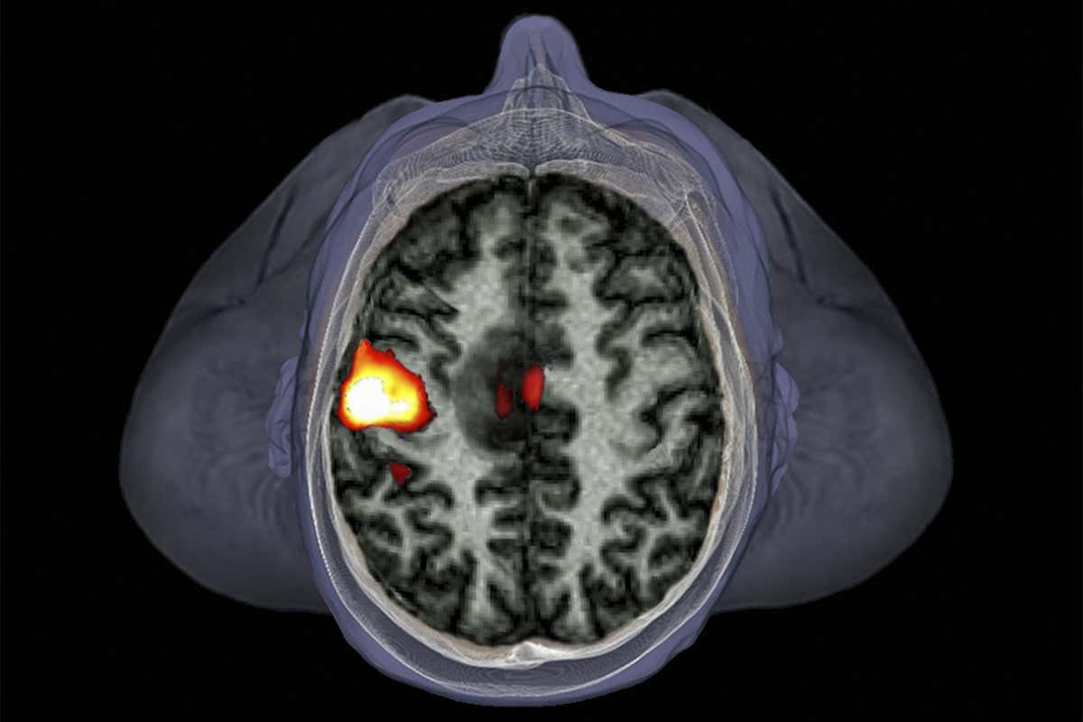
fMRI will be the method of choice for calibrating high-level cognitive processes
Non-invasive
1000+ people can be measured to map population heterogeneity
Can read deep inside the brain
Can read the entire brain at once
Main disadvantage: low SNR and spatial resolution (1mm³)
Will be mitigated by future advances in scanner technology

Slide 25
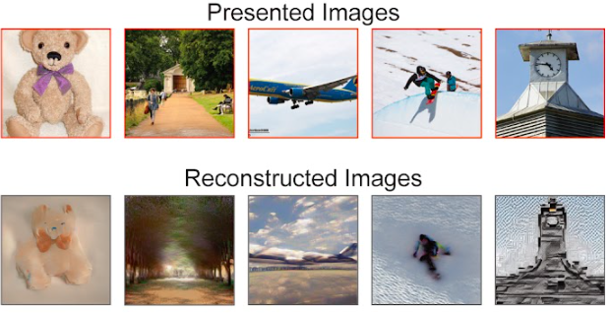
Progress so far: fMRI visual decoding
Nishimoto et al, Curr Biol 2012

Slide 26
Progress so far: fMRI visual decoding
Takagi et al, CVPR 2023

Slide 27
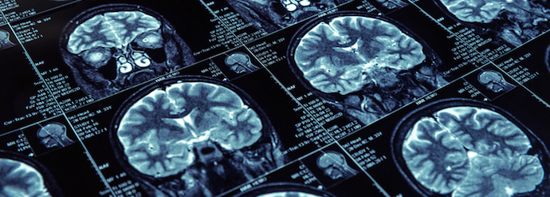
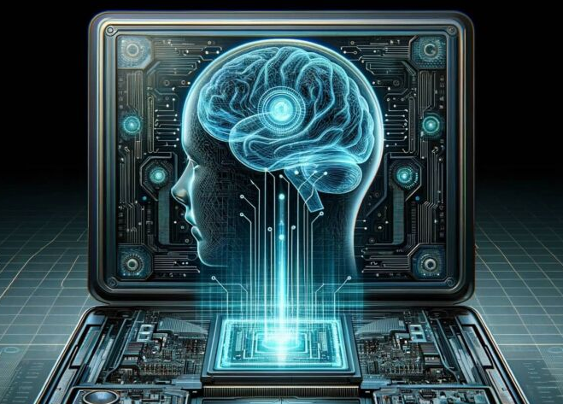
Conclusion + What is Next?
MRI + AI technology is advancing at a rapid pace
Breakthroughs in disease diagnosis and characterization
Will play a crucial role in whole brain emulation, esp. calibration
More progress is needed for:
Better MRI hardware
Algorithms, AI, simulators for analysis
Revolution in brain-computer interfaces and whole brain emulation
Mind uploading
Digital avatars
Artificial consciousness

